Slide 1
Title: Landslide Dataset Analysis Using EDA Include: Your Name: Abhay Chaudhary Reg. No: 12315216 Course Code: INT375 Guide: Mrs. Aashima Bansal Lovely School of Computer Science and Engineering Lovely Professional University, Phagwara

Slide 2
🌍 Global Landslide Analysis
Introduction
Landslides are destructive natural events that can lead to loss of life and property. This project uses global landslide data to explore causes, patterns, and impacts through Exploratory Data Analysis (EDA) using Python libraries like Pandas, Matplotlib, and Seaborn.
1.1 Background
Landslides cause major damage to people, infrastructure, and the environment. Understanding their triggers is key to building early warning systems and prevention strategies.
1.2 Objectives
The aim is to study global landslide trends, identify risk factors, and find patterns using historical data.
1.3 Importance of Analysis
Analyzing landslide data helps identify vulnerable areas and time periods, aiding disaster preparedness and risk reduction.

Slide 3
Exploratory Data Analysis (EDA) Process (Understanding and Preparing the Landslide Dataset) Exploratory Data Analysis (EDA) is the process of analyzing datasets to: - Understand structure and characteristics - Detect missing data, outliers, and anomalies - Identify patterns, correlations, and trends - Prepare data for modeling and predictions Goal: Gain insights and prepare clean, structured data for analysis. Steps Followed in EDA 1.Load Dataset: Using pandas.read_csv() 2. Inspect Structure: Use df.head(), df.info(), df.shape 3. Handle Missing Values: Fill or drop nulls based on type 4. Convert Dates: Use pd.to_datetime() for event_date 5. Replace Nulls with 0: For numeric fields like fatalities, injuries 6. Detect Outliers: Use Interquartile Range (IQR) method

Slide 4
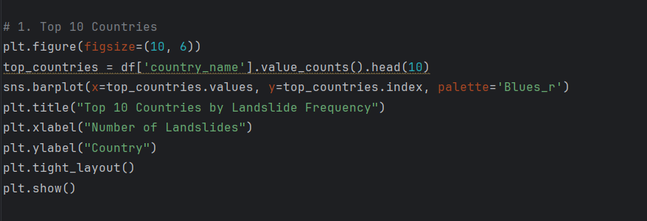
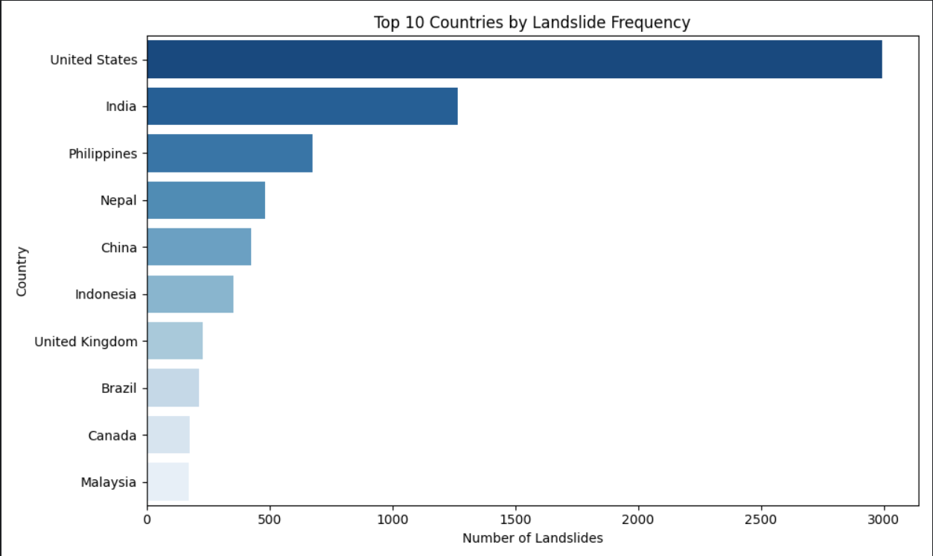
🎯 OBJECTIVE 1: Identify the Top 10 Countries by Landslide Frequency
Goal:
To determine which countries experience the highest number of landslides using historical data.
Method:
Count the number of landslide events per country using value_counts().
Select the top 10 using head(10).
Visualize with sns.barplot().
Visualization:
Bar chart of top 10 countries with the most landslide incidents.
Result:
India, USA, Nepal, and Indonesia are among the top affected countries.
These countries often have mountainous terrain and heavy seasonal rainfall.
Conclusion:
This shows the geographical distribution and highlights high-risk regions, helping prioritize safety measures in those areas.

Slide 5
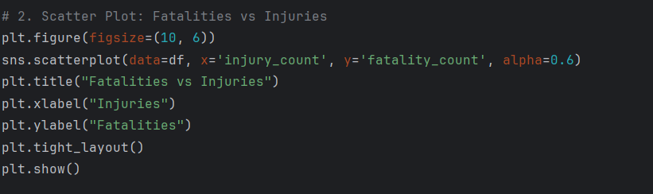
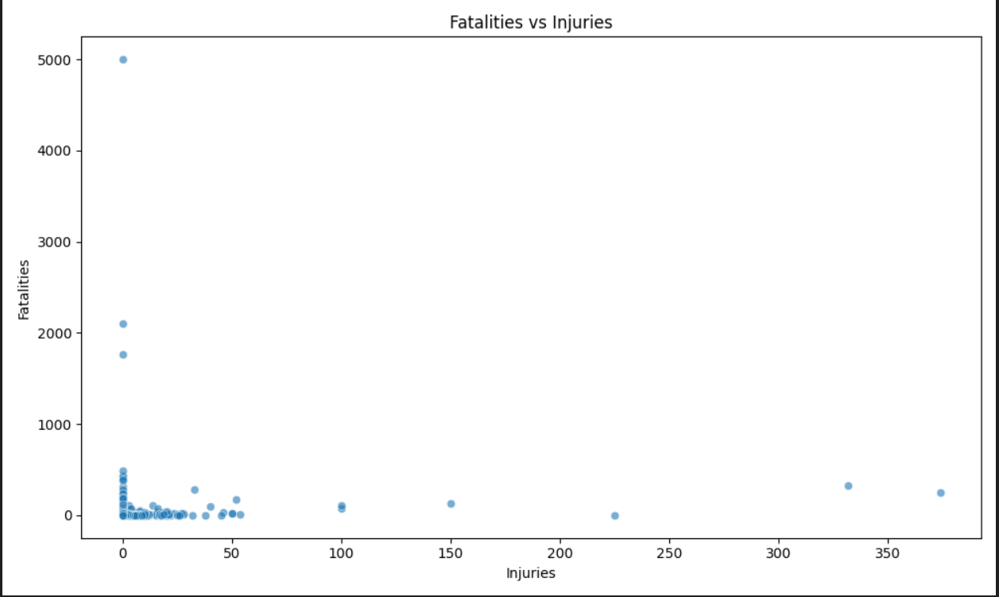
🎯 OBJECTIVE 2: Analyze Fatalities vs Injuries
Goal:
To understand the relationship between the number of injuries and fatalities in landslides.
Method:
Used sns.scatterplot() with:
X-axis: Injuries
Y-axis: Fatalities
Visualization:
Scatter plot showing distribution of events based on injuries and deaths.
Result:
Most landslide events involve low injuries and fatalities.
However, a few outliers (extreme cases) result in very high death tolls.
Conclusion:
While most landslides are not fatal, rare catastrophic events do occur, underlining the importance of early warning systems and rescue readiness.

Slide 6
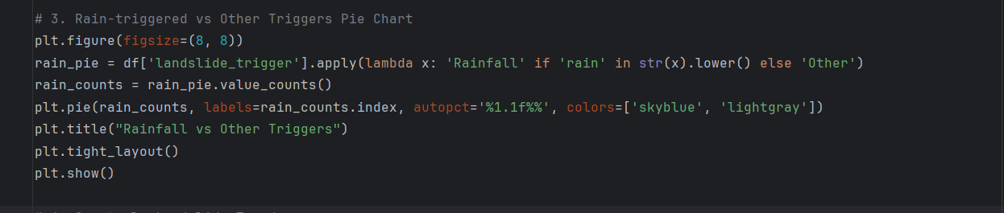
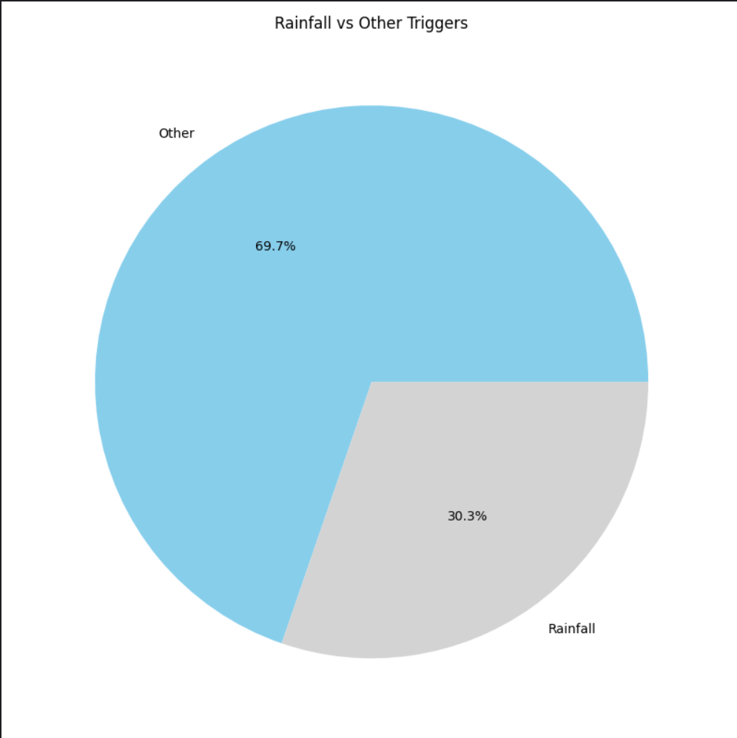
🎯 OBJECTIVE 3: Compare Rainfall vs Other Triggers
Goal:
To evaluate whether rainfall is the main trigger compared to other causes like earthquakes, volcanoes, or construction.
Method:
Apply lambda function to classify triggers as “Rainfall” or “Other”.
Count frequency using value_counts().
Use plt.pie() or bar chart for visualization.
Visualization:
Pie chart showing the percentage of rainfall-triggered vs. other-triggered landslides.
Result:
Rainfall is the most frequent trigger by a large margin.
Supports the idea that weather monitoring is vital for landslide prediction.
Conclusion:
Prevention efforts should focus on rainfall forecasting, especially during monsoon seasons.
.

Slide 7
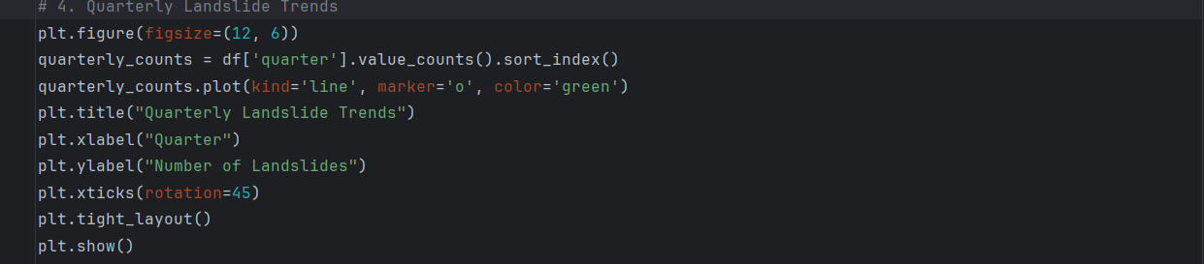
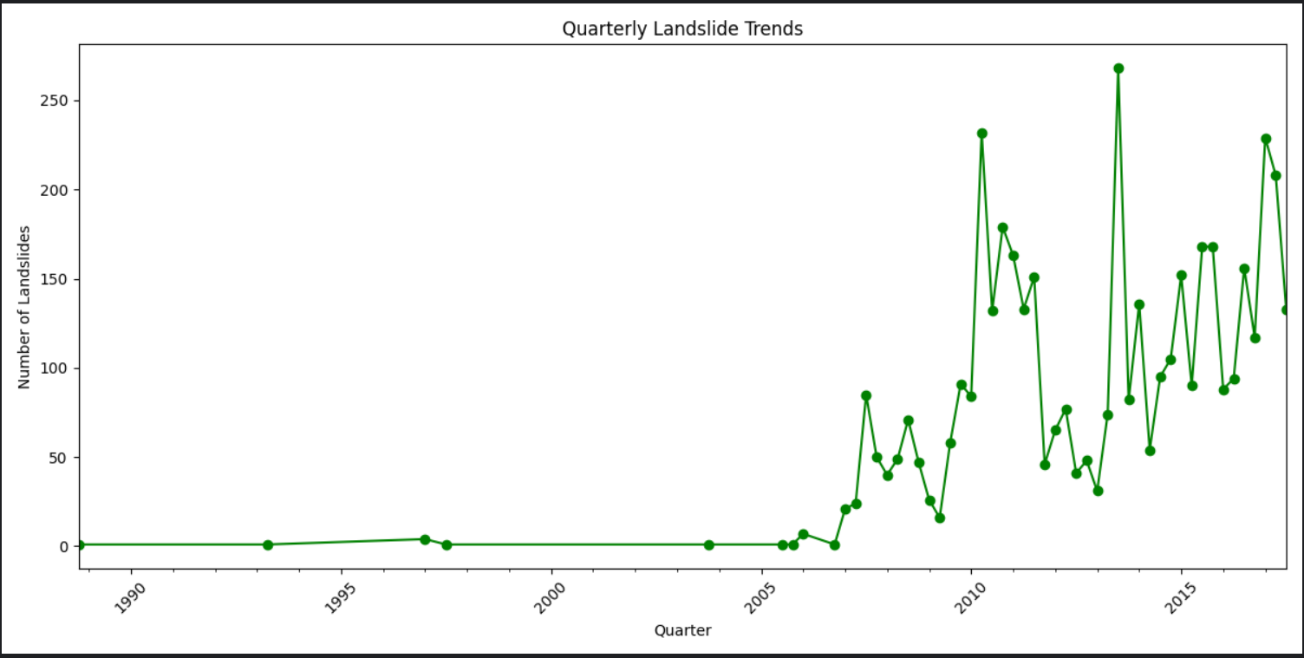
🎯 OBJECTIVE 4: Quarterly Landslide Trends
Goal:
To detect seasonal patterns in landslide occurrences.
Method:
Convert event dates to quarters using dt.to_period('Q').
Count occurrences per quarter.
Use a line plot to show quarterly frequency.
Visualization:
Line graph showing frequency of landslides by quarter.
Result:
Peak landslide activity observed during Q2 and Q3.
These quarters align with monsoon/rainy seasons in many countries.
Conclusion:
Landslide risk is seasonal; emergency services and infrastructure teams can prepare in advance during high-risk months.

Slide 8
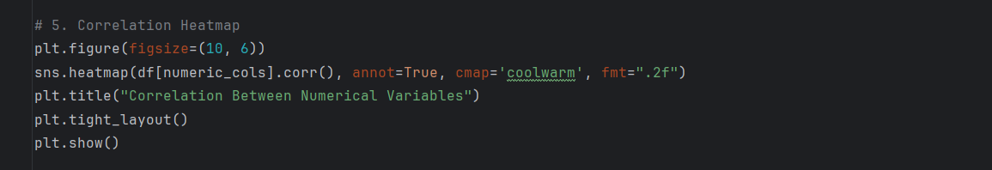
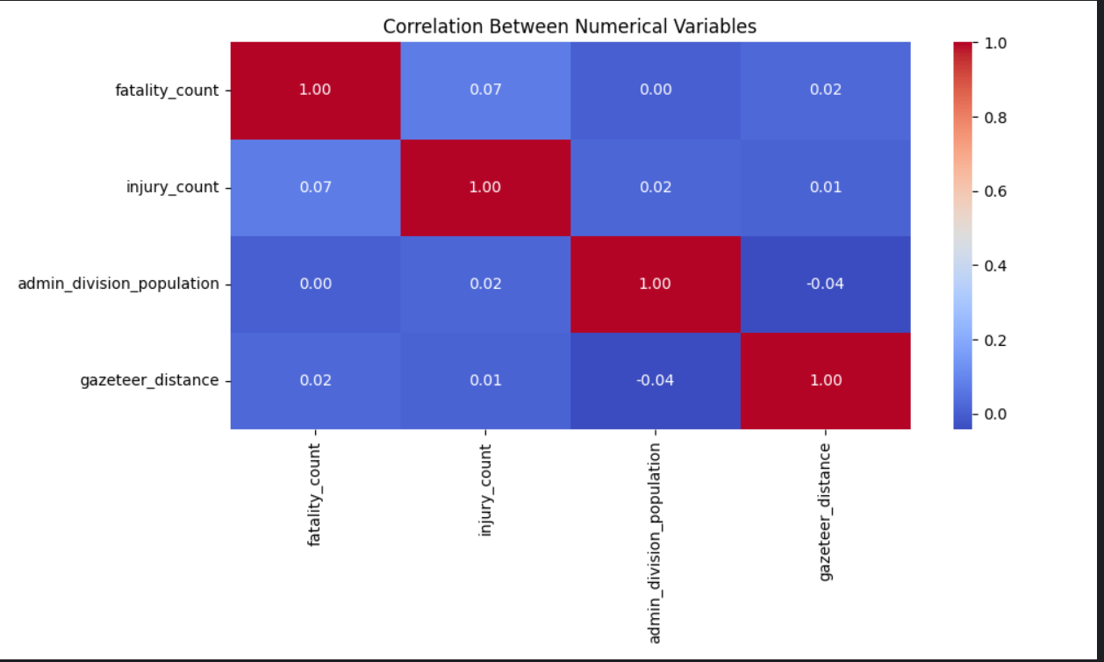
OBJECTIVE 5: Correlation Heatmap of Numerical Variables
Goal:
To explore relationships among numerical variables like:
Fatalities
Injuries
Population
Distance from settlements, etc.
Method:
Use df.corr() to generate correlation matrix.
Visualize with sns.heatmap() (with annot=True).
Visualization:
Correlation heatmap with colors representing strength and direction of correlation.
Result:
No strong positive correlations.
Some weak negative correlations, e.g., higher population doesn’t always mean more fatalities.
Suggests complex interactions between variables.
Conclusion:
Simple linear relationships don't fully explain landslide impacts — advanced models may be needed for accurate prediction.

Slide 9
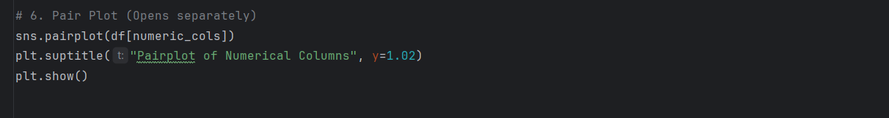
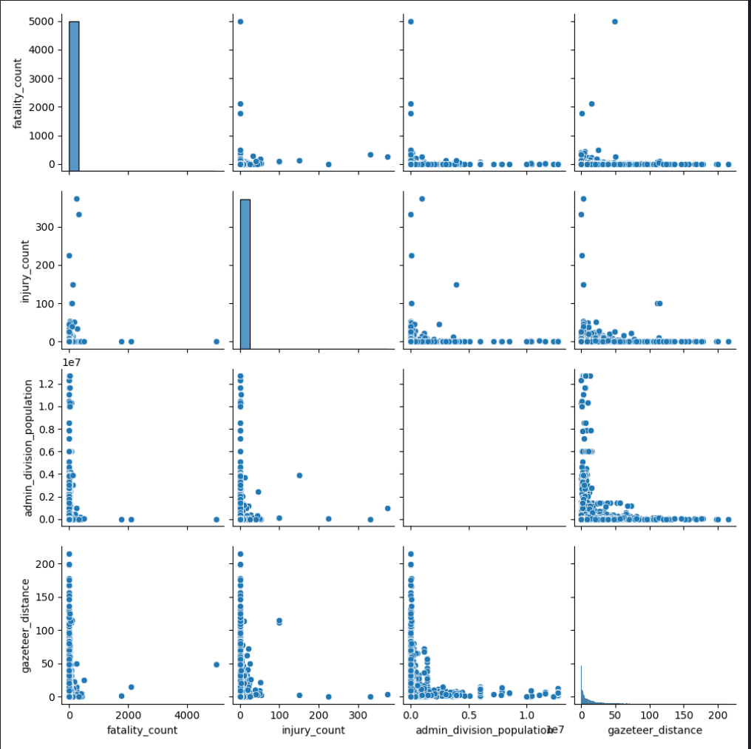
Pair Plot of Numerical Variables
Goal:
To visually explore the distribution and pairwise relationships among multiple numeric fields.
Method:
Use sns.pairplot() on numeric fields like:
Fatalities
Injuries
Rainfall
Slope angle, etc.
Visualization:
Grid of scatter plots (for pairwise relations) and histograms (for distribution).
Result:
Reveals outliers clearly.
No strong linear patterns, but useful for spotting anomalies and data structure.
Conclusion:
Pair plots help visually validate assumptions and identify data irregularities before modeling.

Slide 10
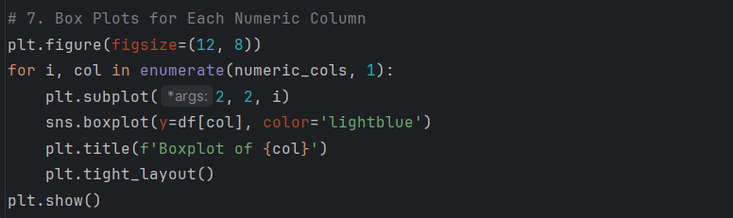
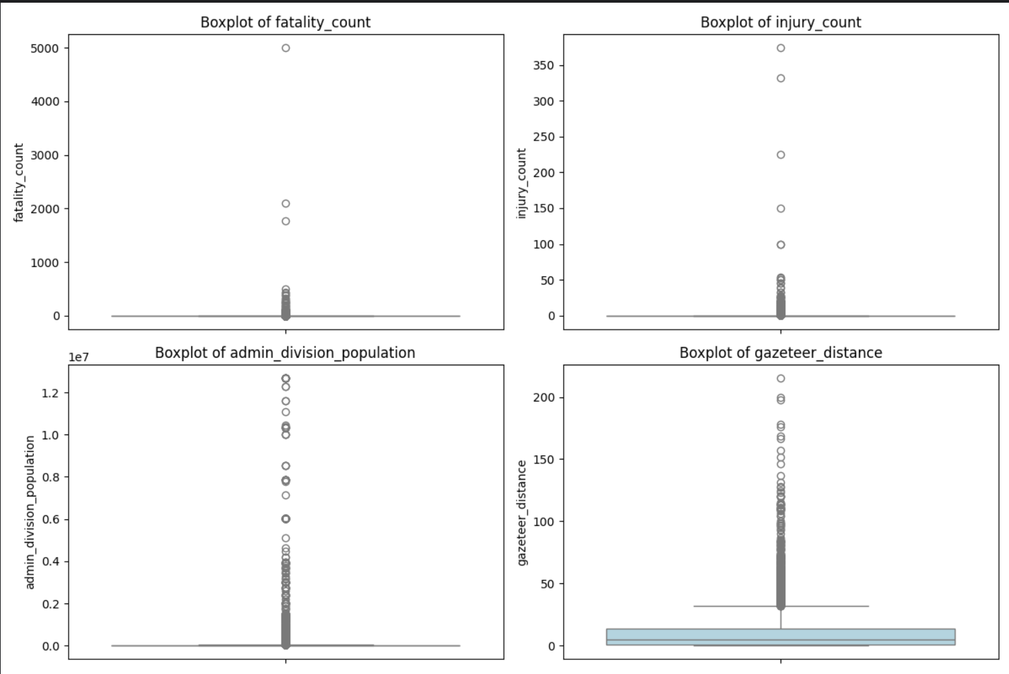
Box Plots for Each Numeric Column Goal: To detect outliers and understand the spread and distribution of individual numeric columns in the dataset. Method: Box plots were created for key numerical variables such as: Fatalities Injuries Rainfall Slope Angle, etc. Each plot was arranged in a grid to enable side-by-side comparison of distributions. Visualization: The box represents the middle 50% of the data (interquartile range). The line inside the box shows the median. Whiskers extend to show the full range of the data (excluding outliers). Dots outside the whiskers indicate outliers. Result: Some variables showed a large number of outliers, especially fatalities and rainfall. Helped understand data variability, skewness, and potential errors in values. Conclusion: Box plots are crucial for spotting anomalies and assessing the statistical summary of each variable. This insight helps guide decisions on data cleaning and feature selection for further analysis.

Slide 11
Summary of Objectives and Results:
Objective | Goal | Method Used | Key Insight
1. Top Countries | Find high-frequency regions | Bar chart | India, Nepal, USA most prone
2. Fatalities vs Injuries | Analyze severity | Scatter plot | Most events mild, few extreme
3. Rainfall vs Other | Determine main trigger | Pie chart | Rainfall is dominant trigger
4. Quarterly Trends | Seasonal pattern | Line plot | Spikes during monsoon
5. Correlation | Understand relationships | Heatmap | Weak correlations overall
6. Pair Plot | Visual exploration | Pairplot | Useful for spotting outliers
7. Box Plots | Detect outliers and understand spread | Box plots for numeric columns | Shows variability, skewness, and outliers clearly

Slide 12
Thankyou

